Slide 1
Morphological
Morphological operations apply a structuring element to an input image, creating an output image of the same size. In a morphological operation, the value of each pixel in the output image is based on a comparison of the corresponding pixel in the input image with its neighbors.
Morphological operations rely only on the relative ordering of pixel values, not on their numerical values, and therefore are especially suited to the processing of binary images.
Morphological techniques probe an image with a small shape or template called a structuring element. The structuring element is positioned at all possible locations in the image and it is compared with the corresponding neighbourhood of pixels. Some operations test whether the element "fits" within the neighbourhood, while others test whether it "hits" or intersects the neighbourhood:

Slide 2
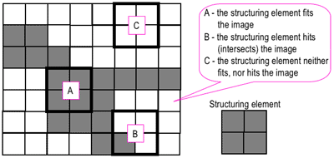

Slide 3
structuring element
The structuring element is a small binary image, i.e. a small matrix of pixels, each with a value of zero or one:
The matrix dimensions specify the size of the structuring element.
The pattern of ones and zeros specifies the shape of the structuring element.
An origin of the structuring element is usually one of its pixels, although generally the origin can be outside the structuring element.
A common practice is to have odd dimensions of the structuring matrix and the origin defined as the centre of the matrix. Stucturing elements play in moprphological image processing the same role as convolution kernels in linear image filtering.

Slide 4
Types of Morphological Operations
1. Morphological Dilation and Erosion
The most basic morphological operations are dilation and erosion. Dilation adds pixels to the boundaries of objects in an image, while erosion removes pixels on object boundaries. The number of pixels added or removed from the objects in an image depends on the size and shape of the structuring element used to process the image. In the morphological dilation and erosion operations, the state of any given pixel in the output image is determined by applying a rule to the corresponding pixel and its neighbors in the input image. The rule used to process the pixels defines the operation as a dilation or an erosion.

Slide 5
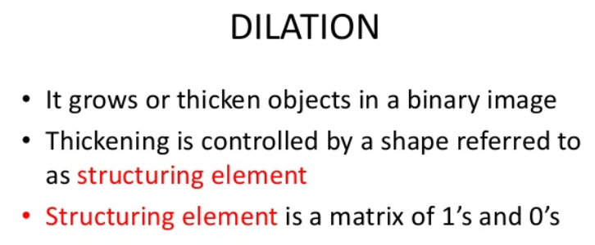

Slide 6
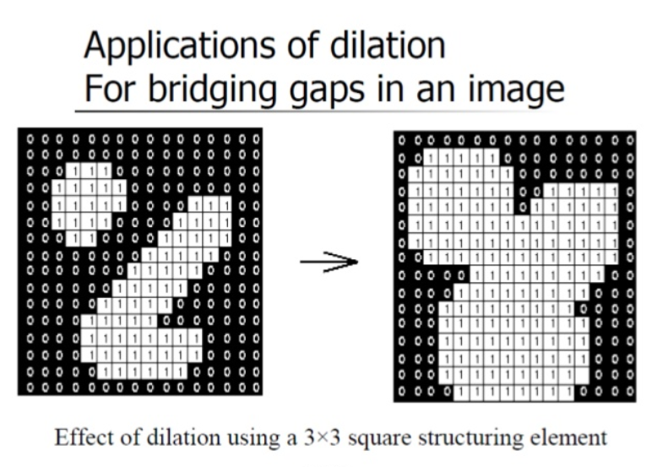

Slide 7
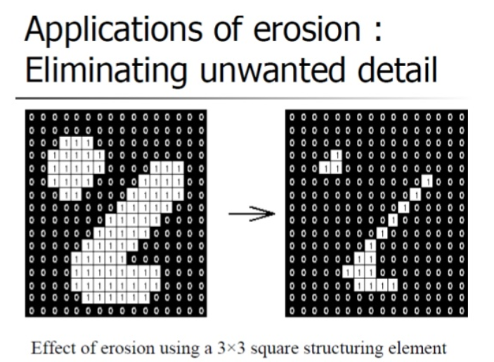

Slide 8
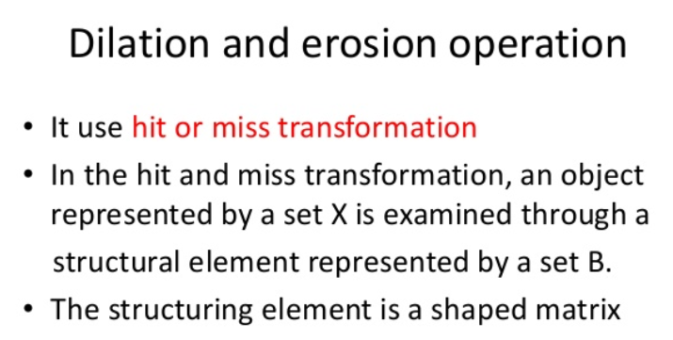

Slide 9
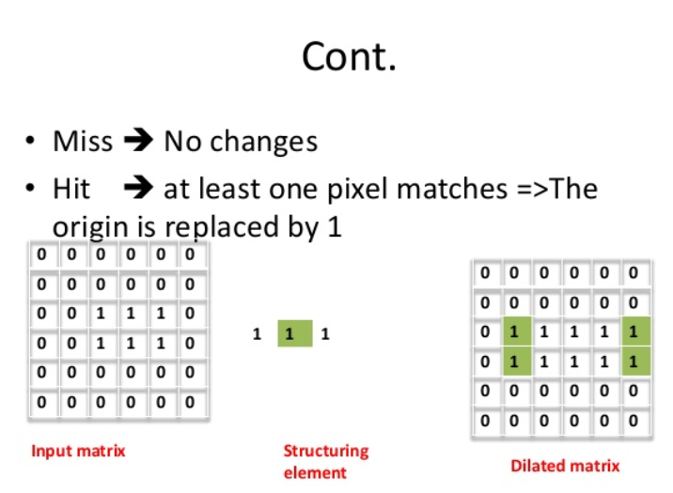

The dilation of an image f by a structuring element s (denoted ) produces a new binary image g = with ones in all locations (x,y) of a structuring element's orogin at which that structuring element s hits the the input image f, i.e. g(x,y) = 1 if s hits f and 0 otherwise, repeating for all pixel coordinates (x,y). Dilation has the opposite effect to erosion -- it adds a layer of pixels to both the inner and outer boundaries of regions.

Slide 10
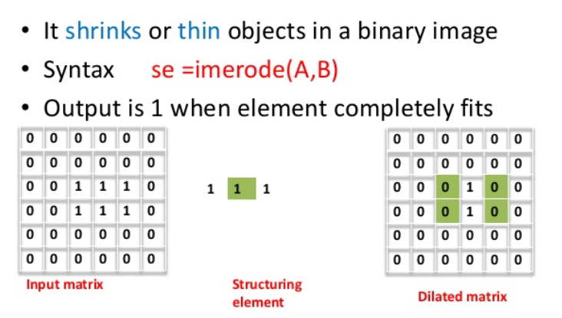

Erosion
The erosion of a binary image f by a structuring element s (denoted ) produces a new binary image g = with ones in all locations (x,y) of a structuring element's origin at which that structuring element s fits the input image f, i.e. g(x,y) = 1 is s fits f and 0 otherwise, repeating for all pixel coordinates (x,y).
Erosion removes small-scale details from a binary image but simultaneously reduces the size of regions of interest, too. By subtracting the eroded image from the original image, boundaries of each region can be found: b = f − ( ) where f is an image of the regions, s is a 3×3 structuring element, and b is an image of the region boundaries.

Slide 11
opening
The opening of an image f by a structuring element s (denoted by ) is an erosion followed by a dilation:
Opening is so called because it can open up a gap between objects connected by a thin bridge of pixels. Any regions that have survived the erosion are restored to their original size by the dilation

Slide 12

The closing of an image f by a structuring element s (denoted by f •s) is a dilation followed by an erosion
Closing is so called because it can fill holes in the regions while keeping the initial region sizes

Slide 13


Slide 14
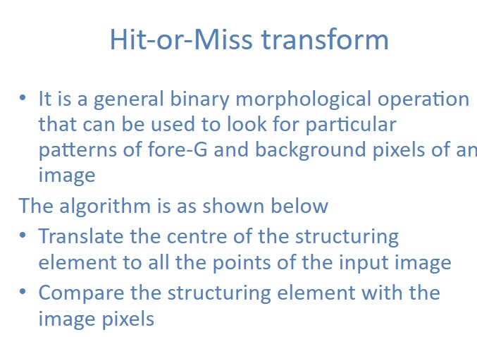

Slide 15
